Slide 1


Slide 2


OUR TEAM
Vidita Pawan
Altaf Mulani
Rishabh
Sharma
Rishabh Chugh

Slide 3

CONTENT
01
ABOUT PROJECT
02
OUR TEAM
03
GOALS/TARGETS
04
METHODOLOGY
05
INSIGHTS
06
ANALYSIS
07
CHALLANGES
08
CONCLUSION

Slide 4



ABOUT PROJECT
We have worked upon the data fetching, cleaning and analyzing from the website ‘Naukri.com’
We were able to achieve our desired results wherein we analysed the number of jobs in different sectors among different locations.

Slide 5





GOALS AND OBJECTIVES
Our goals towards the making of this project were--
Employee - User should have ease to choses the best job available.
Insights -
Some insights for clients to analyze, which job is more in demand.
Getting info about job vacancies in different sectors across different geographic and demographic locations.

Slide 6
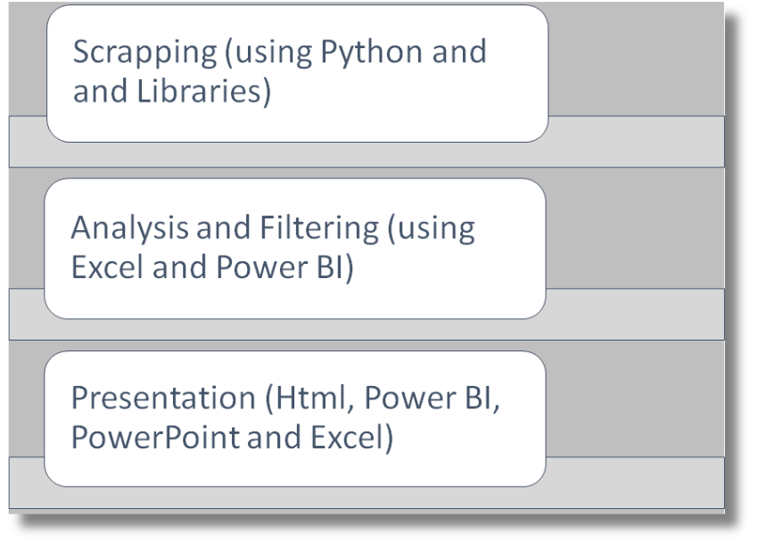
Project Execution
(Methodology):

Slide 7
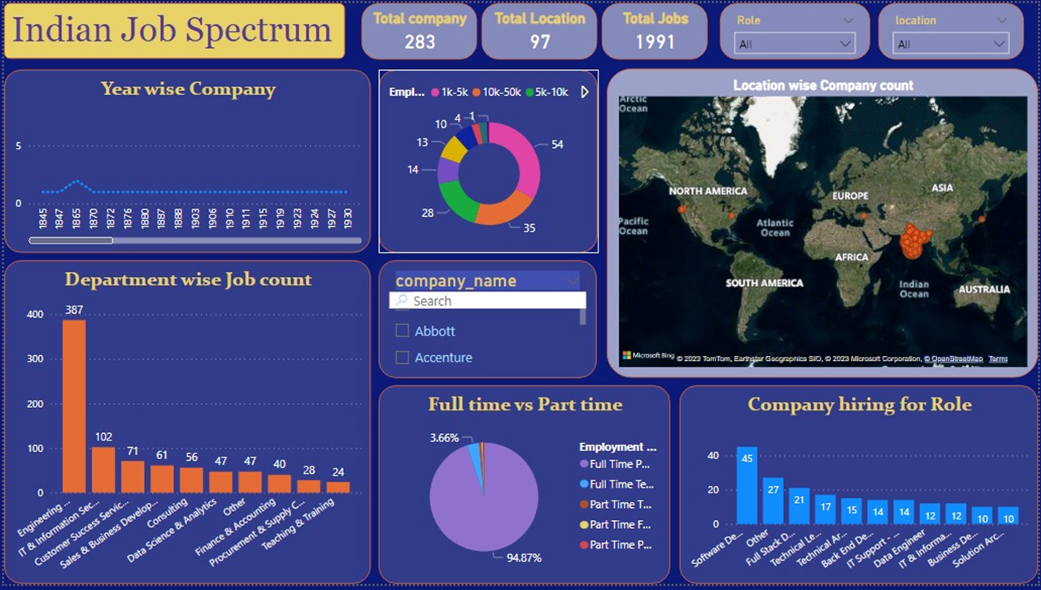

Slide 8
Insights:
After 1980 there is a boom in the IT field
There are small and medium sized companies more in numbers as compared to large IT giants.
There are more job openings in Bangalore as compared to other cities.
Mumbai and Pune rank after Bangalore.
Engineering field is in high demand
Approximate 95% of companies hire for full time roles
Software Development role is in high demand

Slide 9
Challenges
Learning of a new skill : Web Scrapping
Scrapping of large amounts of data
Stable Network Connection
Needed to ensure that the data collected is reliable, valid, and unbiased to avoid making incorrect decisions based on inaccurate information.

Slide 10
Conclusion
IN CONCLUSION, JOB ANALYSIS IS A CRITICAL PROCESS THAT ORGANIZATIONS MUST UNDERTAKE TO ENSURE THAT THEY HAVE THE RIGHT PEOPLE IN THE RIGHT POSITIONS

Slide 11
THANKS

